Slide 1

ECE6865 Final Project
Using Adaptive Moment Estimation to Optimize CNN for Image Recognition
Zeyu Liu

Slide 2
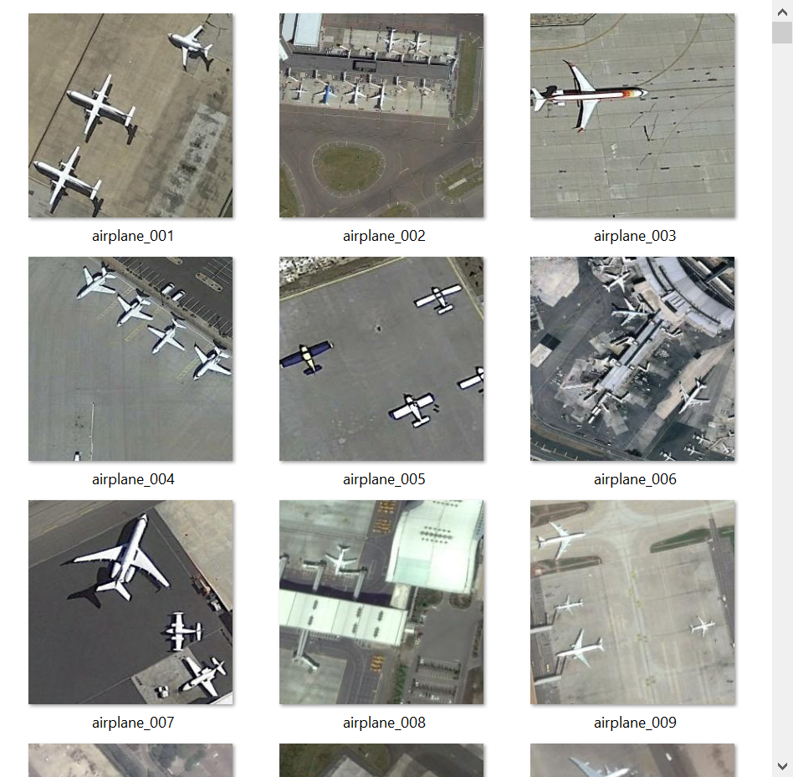
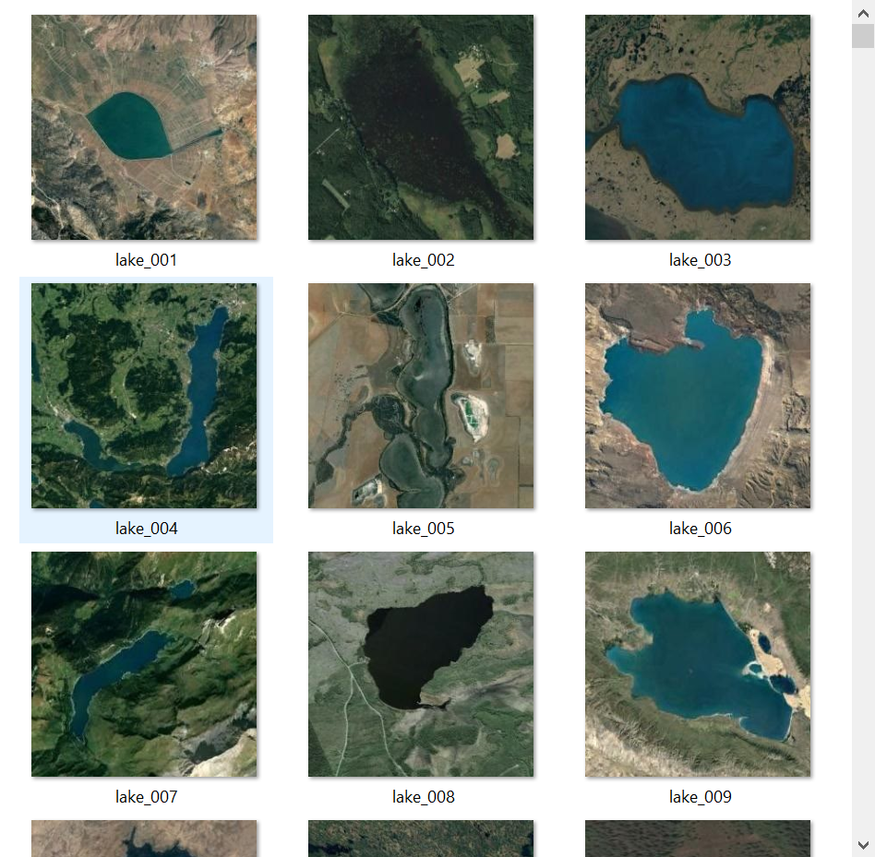
How to recognize and classify the two-class pictures?

Slide 3
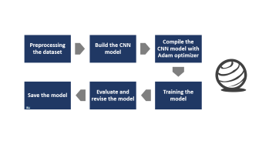
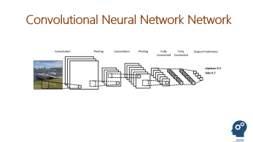
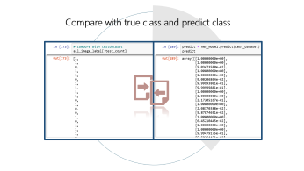
Contents USE ADAM TO OPTIMIZE CNN
The key library I used in python:
tensorflow, matplotlib.pyplot, numpy, pathlib, keras, random, IPython.display.
Concept
Step
Result

Slide 4
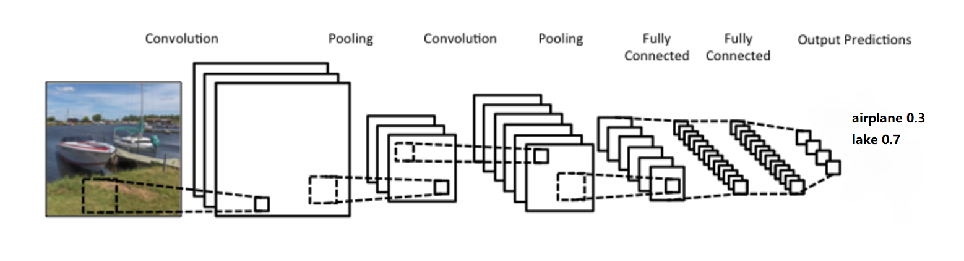
Convolutional Neural Network Network

Slide 5
Convolutional Neural Network Network

Slide 6

Convolution layer
Convolutional Neural Network Network

Slide 7

Maxpooling layer
Convolutional Neural Network Network

Slide 8
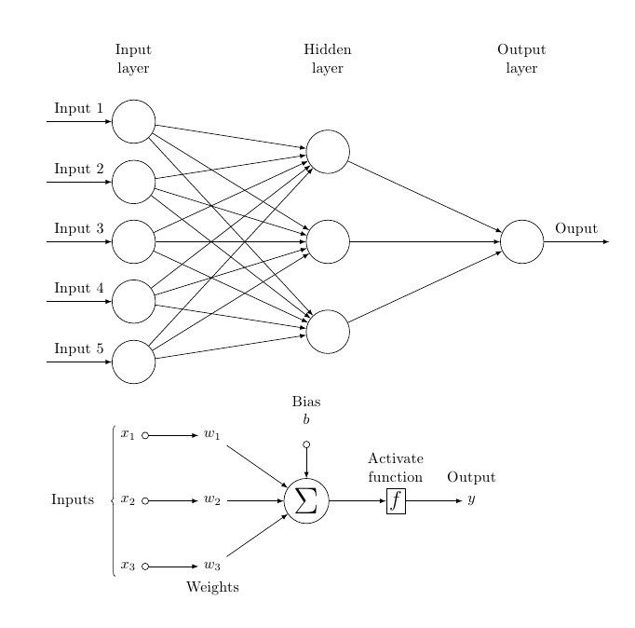

Fully Connected layer
Convolutional Neural Network Network

Slide 9
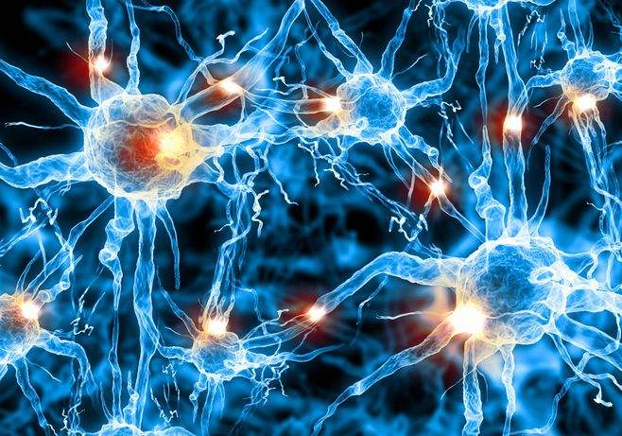
Relu Activation
Rectified linear unit

Slide 10
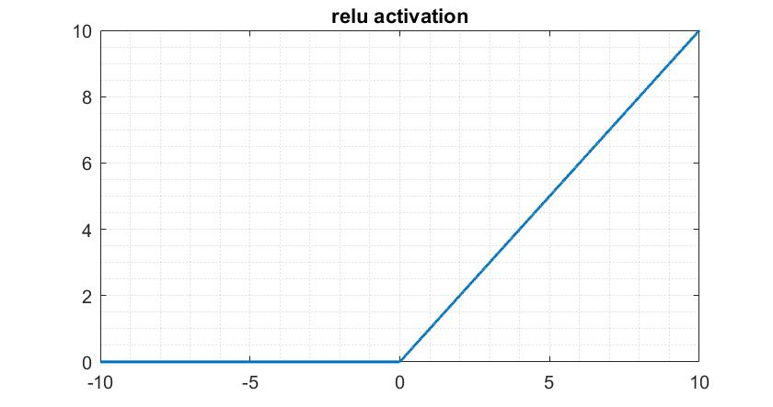
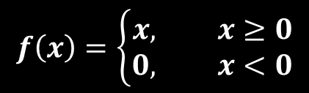
Relu Activation
Rectified linear unit
$$f\left(x\right)=\left\{\begin{aligned}x, &x≥0 \\ 0, &x<0\end{aligned}\right.$$

Slide 11
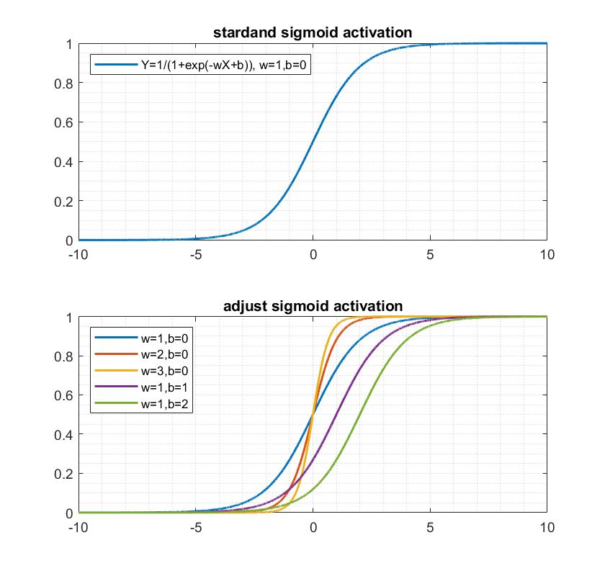
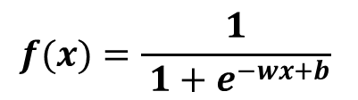
$$f(x)=\frac{1}{ 1+e^{−wx+b}}$$
Sigmoid activation

Slide 12
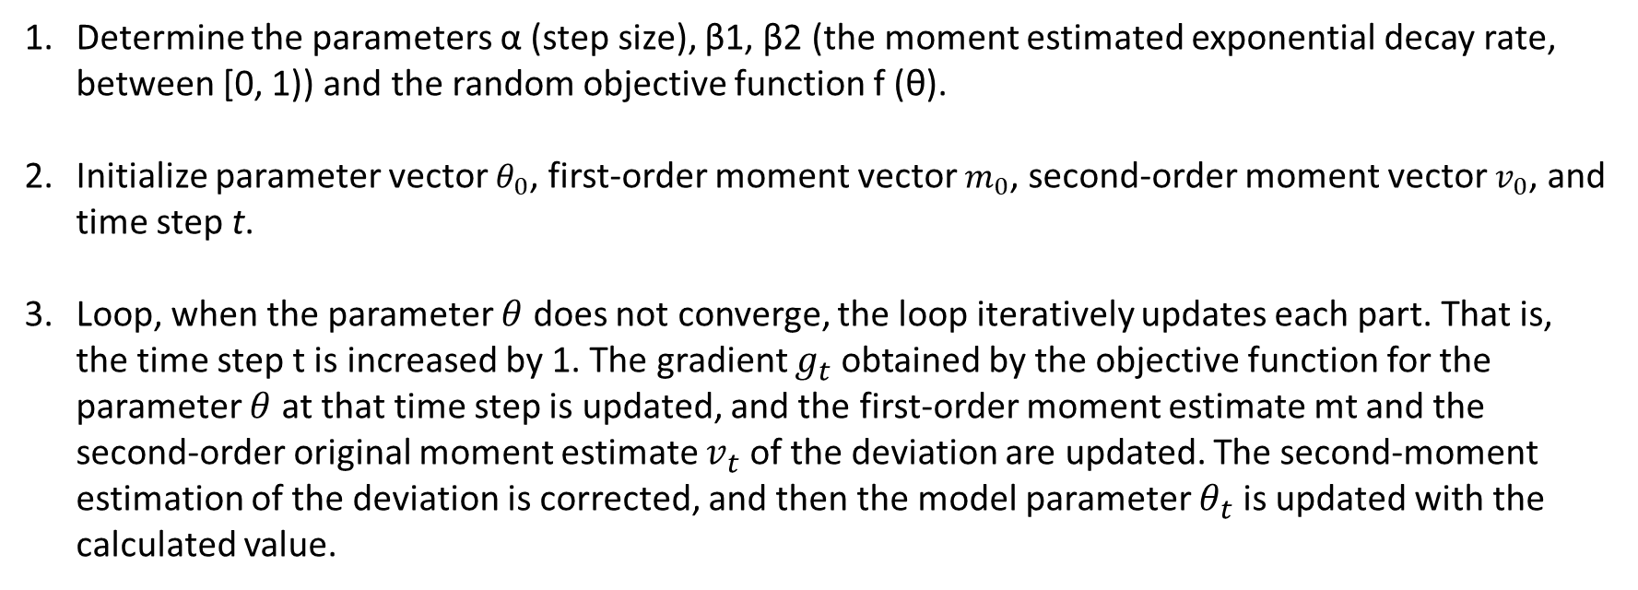
Adam optimizer
Adaptive moment estimation
Determine the parameters α (step size), β1, β2 (the moment estimated exponential decay rate, between [0, 1)) and the random objective function f (θ).
Initialize parameter vector $θ_{0}$, first-order moment vector $m_{0}$, second-order moment vector $v_{0}$, and time step t.
Loop, when the parameter $θ$ does not converge, the loop iteratively updates each part. That is, the time step t is increased by 1. The gradient $g_{t}$ obtained by the objective function for the parameter $θ$ at that time step is updated, and the first-order moment estimate mt and the second-order original moment estimate $v_{t}$ of the deviation are updated. The second-moment estimation of the deviation is corrected, and then the model parameter $θ_{t}$ is updated with the calculated value.
tf.keras.optimizers.Adam(lr=0.001, beta1=0.9, beta2=0.999, epsilon=1e-08)

Slide 13
Loss Binary crossentropy
$\left.J(w,b)=−\frac{1}{N}\sum_{i=1}^{N}{{\left[y\right.}_{i}}log(\hat{y_{i}})+(1−y_{i})log(1−\hat{y_{i}})\right]$, N =2
Binary cross-entropy measures how far away from the true value (which is either 0 or 1) the prediction is for each of the classes and then averages these class-wise errors to obtain the final loss.

Slide 14
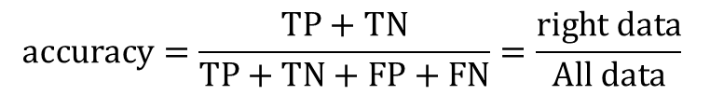
accuracy
$$accuracy=\frac{TP+TN}{TP+TN+FP+FN}=\frac{right data}{All data}$$
 |  | Actual class
 |  | positive class(lake) | negative class(airplane)
Predicted class | positive class (lake) | True Positive (TP) | False Positive (FP)
 | negative class (airplane) | False Negative (FN) | True Negative (TN)
confusion matrix.

Slide 15

Contents USE ADAM TO OPTIMIZE CNN
The key library I used in python:
tensorflow, matplotlib.pyplot, numpy, pathlib, keras, random, IPython.display.
Concept
Step
Result

Slide 16
Preprocessing the dataset
Training the model
Build the CNN model
Compile the CNN model with Adam optimizer
Evaluate and revise the model
Save the model

Slide 17
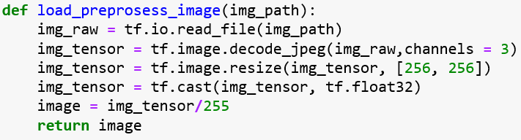
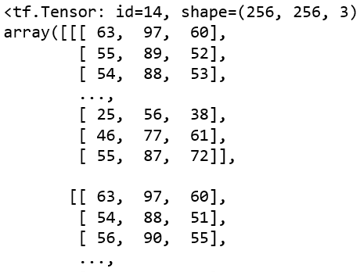
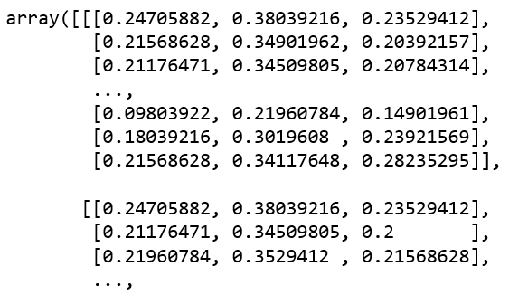
Preprocessing the image

Slide 18
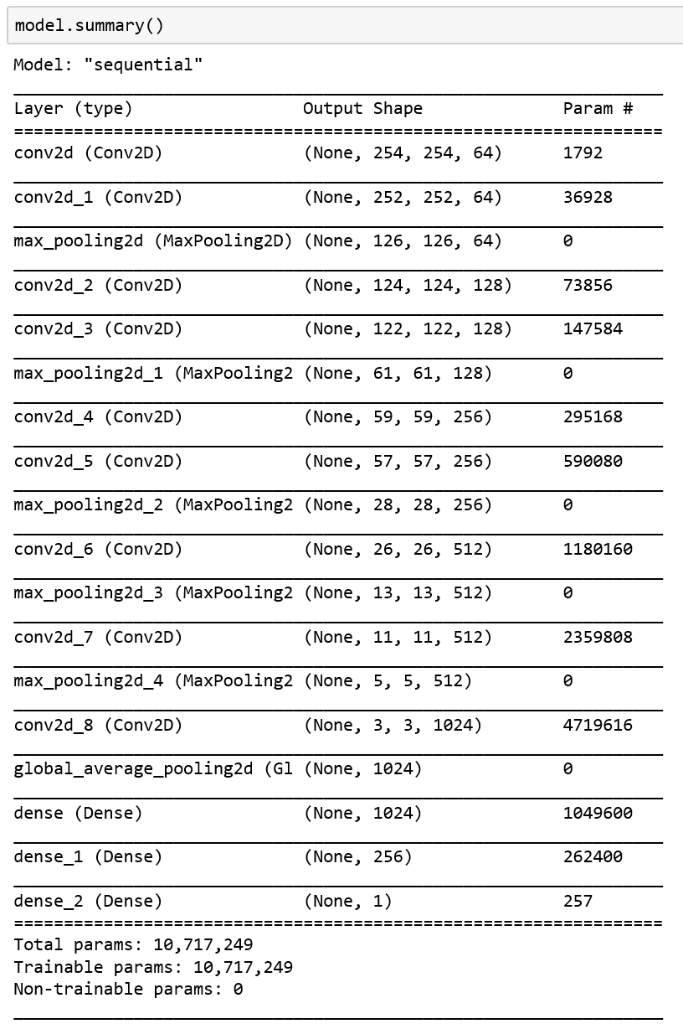
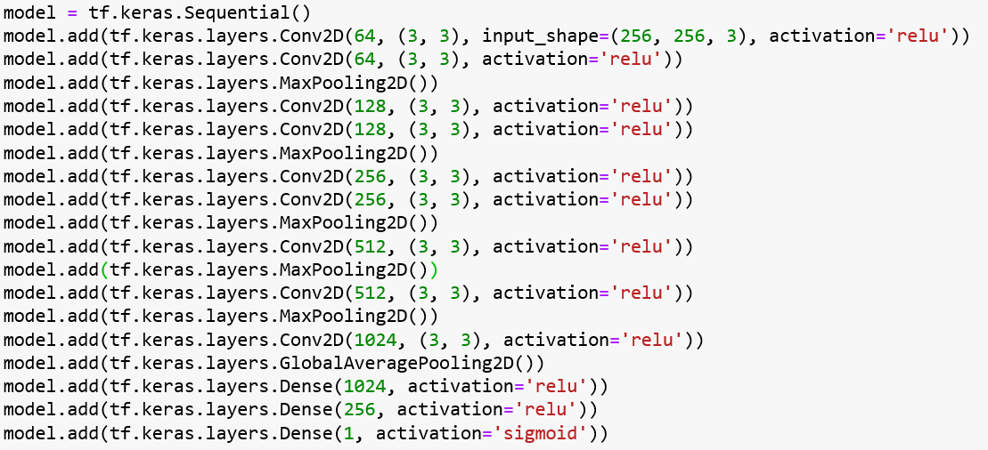
Build the CNN model

Slide 19
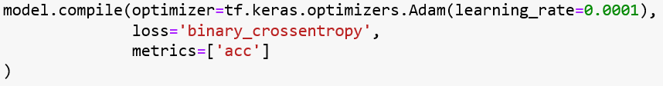
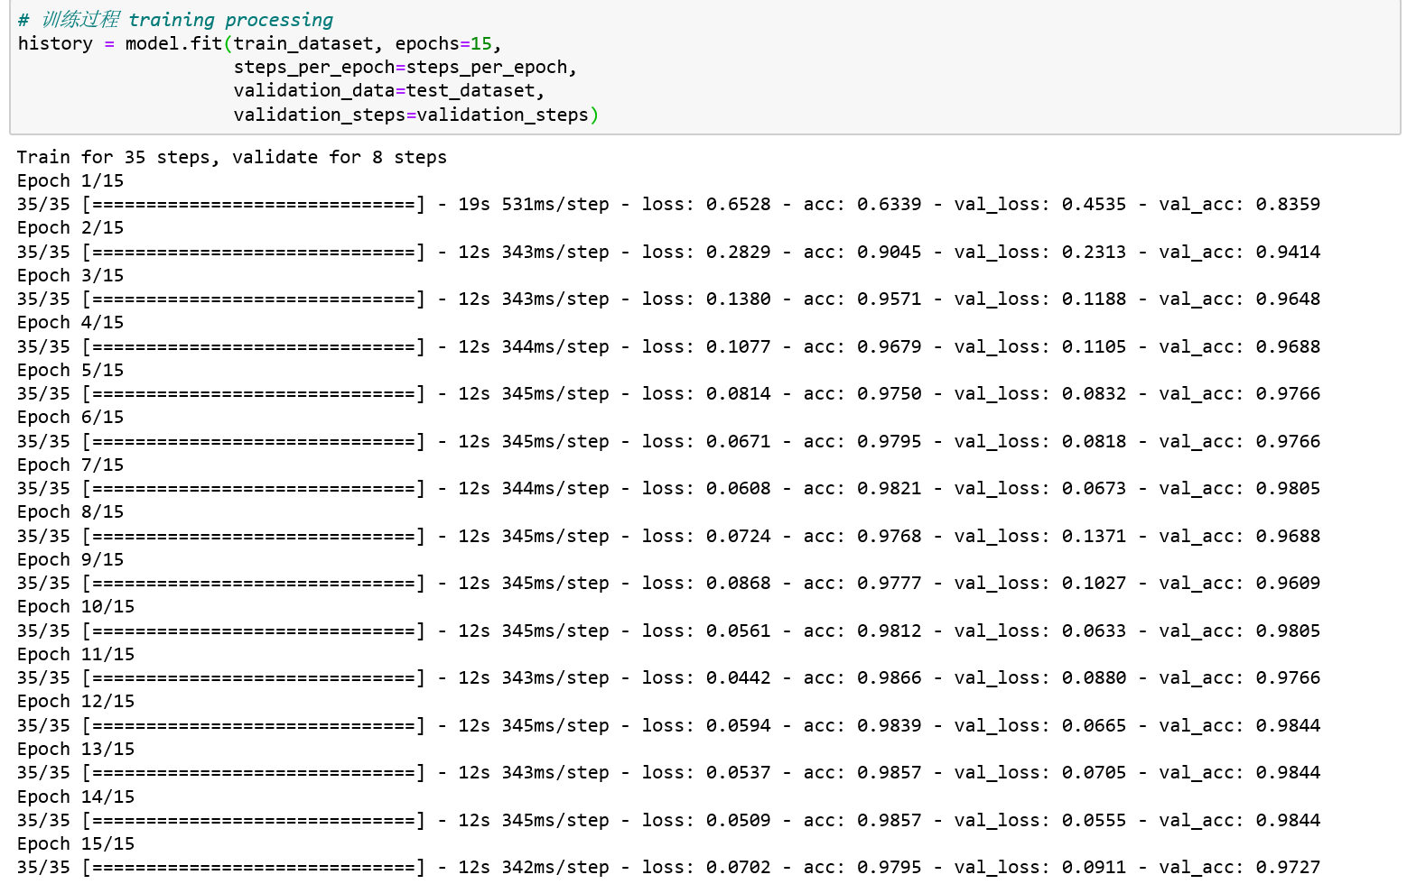
Compile and Train

Slide 20
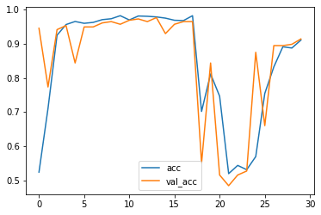
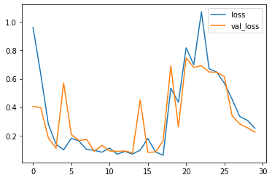
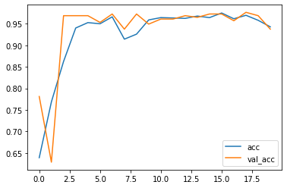
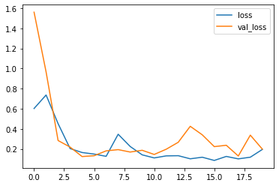
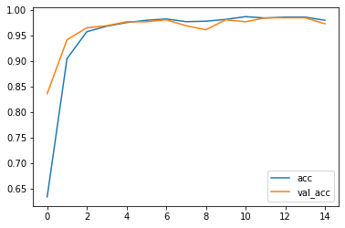
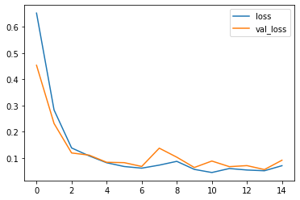
Evaluate and revise the model
the model has a 97.5% validation accuracy and a 0.836 loss
.............................................

Slide 21
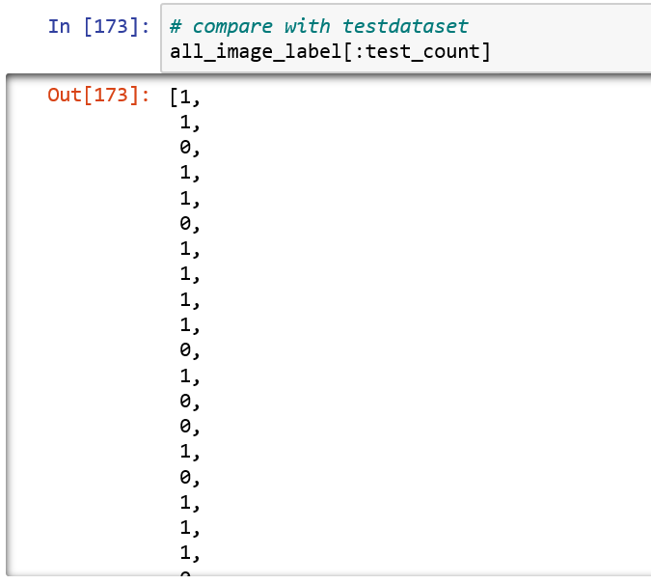
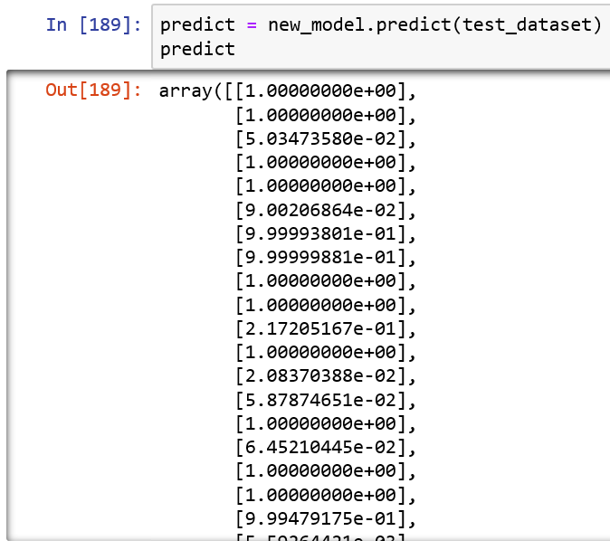
Compare with true class and predict class

Slide 22
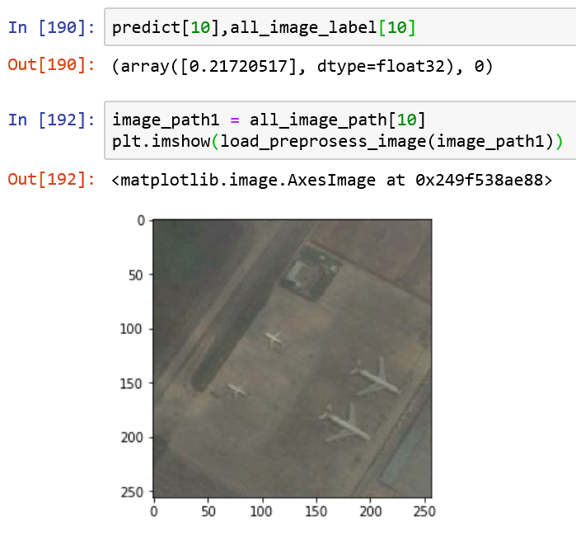
The No.10 pictures in test set.

Slide 23
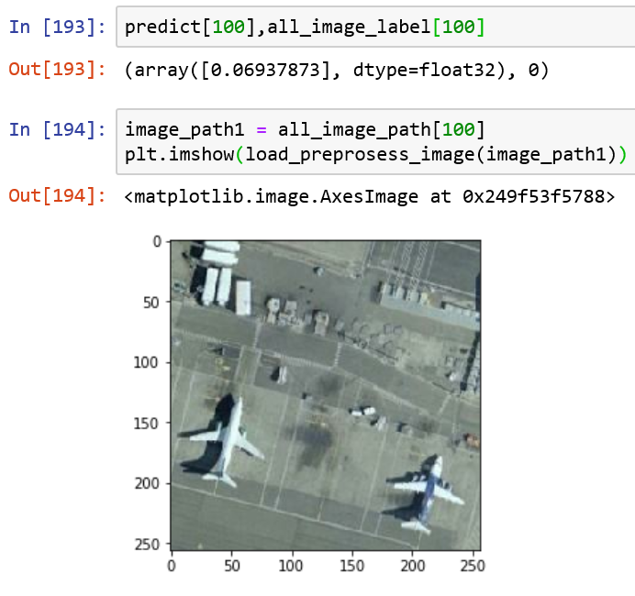
The No.100 pictures in test set.

Slide 24
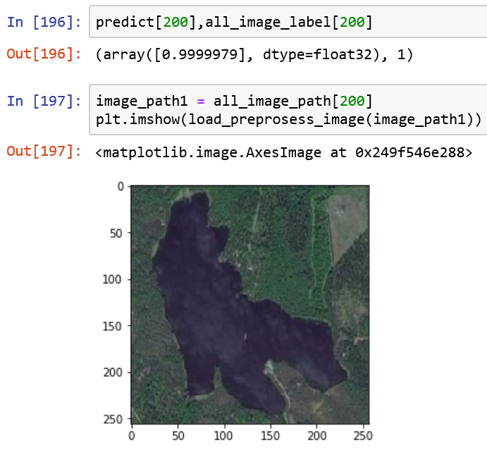
The No.200 pictures in test set.

Slide 25


References
Diederik, Kingma; Ba, Jimmy (2014). "Adam: A method for stochastic optimization". arXiv:1412.6980
Duchi,John,Hazan,Elad,and Singer,Yoram (2011). Adaptive subgradient methods for online learning and stochastic optimization. The Journal of Machine Learning Research, 12:2121–2159.
Karpathy, Andrej. 2015. “Neural Networks Part 1: Setting Up the Architecture.” Notes for CS231n Convolutional Neural Networks for Visual Recognition, Stanford University. http://cs231n.github.io/neural-networks-1/
Murphy, Kevin (2012). Machine Learning: A Probabilistic Perspective. MIT. ISBN 978-0262018029.
Nielsen, M. A. (2015). Neural networks and deep learning (Vol. 25). San Francisco, CA, USA:: Determination press.
Ruder, S. (2016). An overview of gradient descent optimization algorithms. arXiv preprint arXiv:1609.04747.
Tieleman, T. and Hinton, G. Lecture 6.5 - RMSProp, COURSERA (2012): Neural Networks for Machine Learning. Technical report.
Xavier Glorot, Antoine Bordes and Yoshua Bengio (2011). Deep sparse rectifier neural networks. AISTATS.

Slide 26
Thank you for watching
Using Adaptive Moment Estimation to Optimize CNN for Image Recognition
Zeyu Liu

